Slide 1
Blockchain
What will we solve together?
Nitin Gaur
Director IBM Digital Asset Labs
ngaur@us.ibm.com
Notes:
Blockchain for business is ready for production. But the task is much larger than any one business can manage alone. It’ll take a new kind of collaboration between departments and disciplines, industries and organizations, countries and cultures. With hundreds of client projects and dozens of active networks today, IBM Blockchain is helping enterprises, start ups and developers get started on their journey with blockchain to unlock business value, gain unprecedented transparency and operate with newfound trust in financial services, healthcare, government, food safety, supply chains and many other industries. Now it's your turn to be a disruptor. What will we solve together?

Slide 2



We believe by strengthening our trust, we are empowered to change the world.
What will we
solve together?
Notes:
We’re entering a new era where truth isn’t subjective, but collective. Where radical transparency is uprooting how we interact, transact, and grow. We’re finally able to solve problems we thought were just the cost of business.
And behind it all is blockchain. More than a new technology, it’s a whole new playing field. An open system that is creating shared certainty, advancing knowledge, and bringing coalitions together around a single view of truth.
Together, we can do more than ever before — for people, industries, and the planet itself.

Slide 3


We’re entering a new era.
But old problems are still slowing us down.
TRUST DISRUPTION
the digital economy has made trust more important than ever—but also more difficult to establish
DATA DISRUPTION
by not capitalizing on insights uncovered from the world’s next natural resource -- their data.
BUSINESS DISRUPTION
is coming from all around, to achieve future growth collaboration with new kinds of partners will be required.
Notes:
Trust Disruption
The digital economy has made trust more important than ever—but also more difficult to establish
Exponential technology growth hasn’t solved the age old challenge of trust. In fact, growing cybercrime means it’s increasingly difficult to trust transactions in the digital age.
Cybercrime is an increasing concern for business. Security incidents are up by 65% and the average consolidated total cost of a data breach grew to $4 million. (2016 Cost of Data Breach study, sponsored by IBM)
While digital transformation has been embraced across much of business operations, transactions and record-keeping haven’t fully caught up with the digital age and don’t provide the levels of trust required.
Inefficient recordkeeping across your supply chain can stop your business from operating at optimal speed and efficiency.
Data Disruption
Data is the world’s next natural resource and the new competitive advantage. However, not enough companies are tapping into data’s full potential.
Big data keeps getting bigger. 2.5 billion GBs of data are created per day meaning businesses are constantly struggling to keep up with the amounts of information available.
80% of the world’s data is ‘dark data’—unstructured data from sources like online imagery, social media channels, and videos. Companies are only just starting to tap into the potential of unstructured data.
The potential of cloud computing, which gives you the power to track billions of transactions and extract insights from your data faster, is only now starting to be leveraged.
While data sharing is necessary to create value in today’s cross-industry ecosystem, companies are still hesitant to share data due to security concerns.
Business Disruption
Industry convergence and the rise of new competitors and revenue models means enterprise growth increasingly depends on collaborating with new kinds of partners.
Competition from new entrants, players, other industries and even consumers is forcing companies to move faster and more efficiently.
Creating impact at scale in today’s economy requires close collaboration with new types of partners - even those that may be your current competitors.
Global supply chains are becoming more complex, making it increasingly necessary to interact with diverse partners in efficient, transparent, and secure ways.
The potential for business growth within ecosystems is still hampered by disconnected operations.
Enterprises who will win tomorrow are forging new sorts of partnerships today; defining new partnership models that incorporate the shared needs and goals of different kinds of participants.

Slide 4
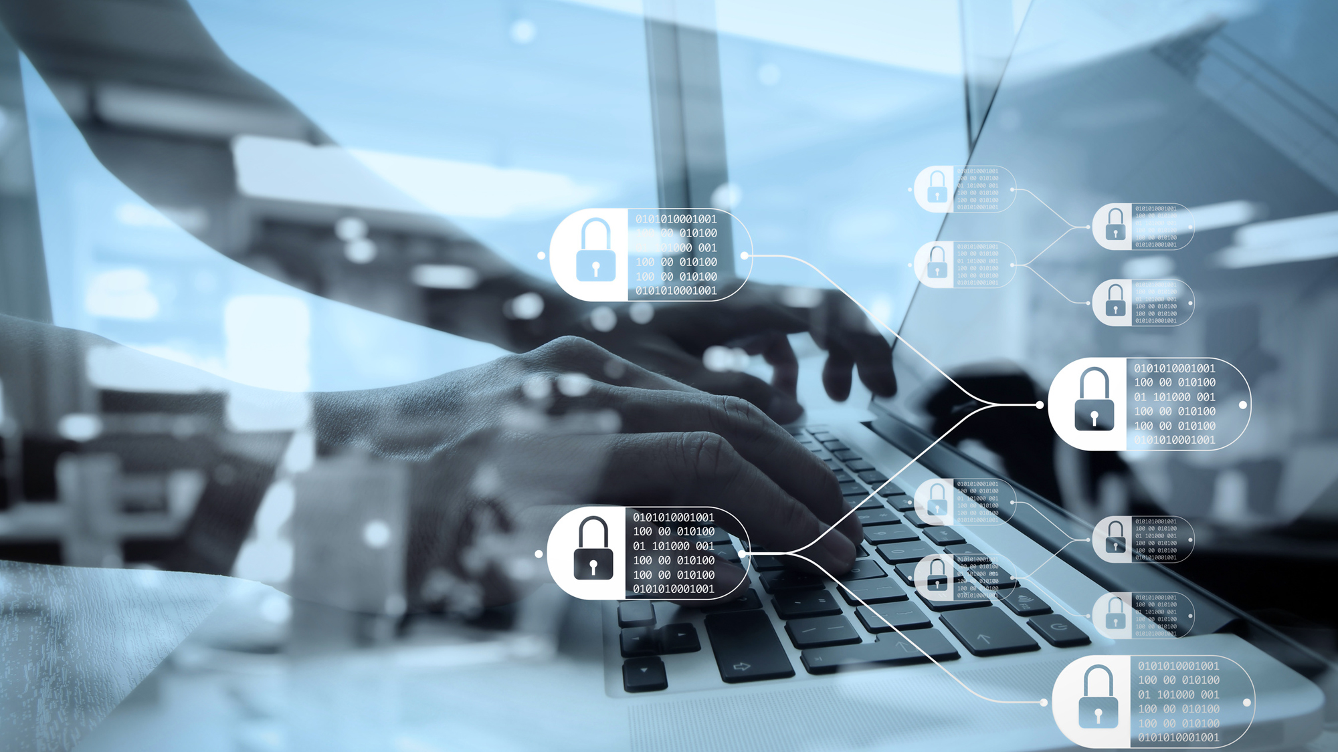

Blockchain and Digital Money
Time
&
Trust
4

Slide 5
Blockchain use cases are emerging in every industry
Banking Supply chain and trade finance Know your customer Transaction banking, payments and digital currencies | Financial Markets Post trade Unlisted security and private equity funds Reference data Cross currency payments Mortgages | Retail Supply chain Loyalty programs Information sharing (supplier – retailer) | Supply Chain Workflow digitization Supply chain visibility Provenance and traceability
Healthcare Mediated health data exchange Clinical trial management Outcome based contracts Medicine supply chain | Manufacturing Supply chain Product parts Maintenance tracking | Governance Asset registry Citizen identity Fraud and compliance | Insurance Complex risk coverage Group benefits Parametric insurance Asset usage history Claims filing

Slide 6
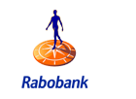

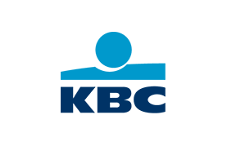





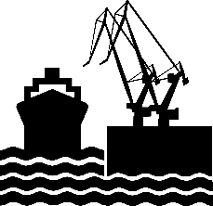
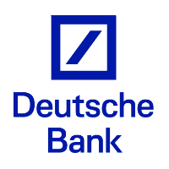

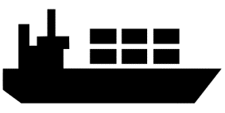


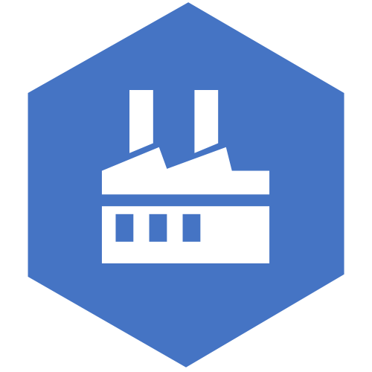
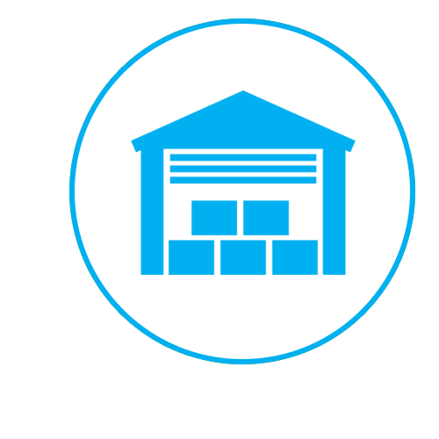


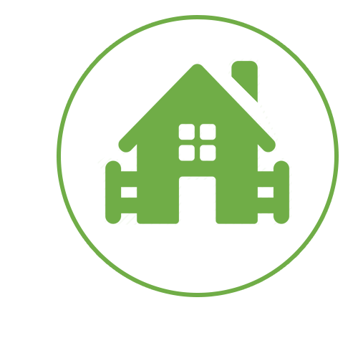
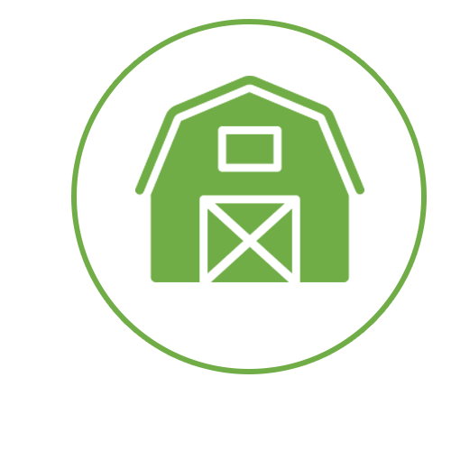
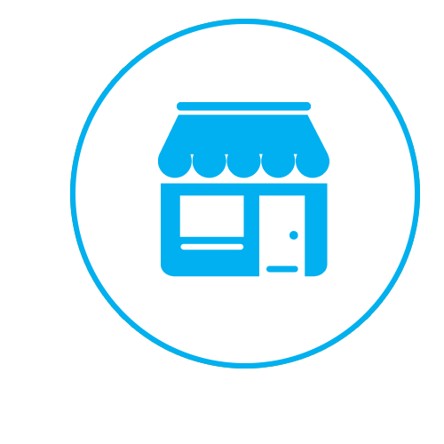
Network of networks: Driving NextGen
economies
Customs / Govt. Agencies
Freight Forwarders
GLOBAL TRADE
FINANCIAL
SERVICES
Trade Finance
Insurance
Payments
Airlines
Provenance
Digitization
Shared Economy
Supply Chain Finance
Insurance
Payments
CONSUMER INDUSTRY
Port Authorities
Ocean Carriers
Agriculture
Wholesale
Suppliers
Consumers
Flowers & Perishables
Wholesale
Retail
Consumers
Cattle Farms
Warehouses
Consumers
Notes:
There are always challenges in bringing together a diverse set of institutions when forming a new digital ecosystem.
The ecosystem has to overcome the fact that they are usually only as
strong as the weakest member;
as fast as their slowest member,
richest as the poorest member (who may be struggling to find funding),
as secure as the most in-secure member
and smartest as their least informed member.

Slide 7
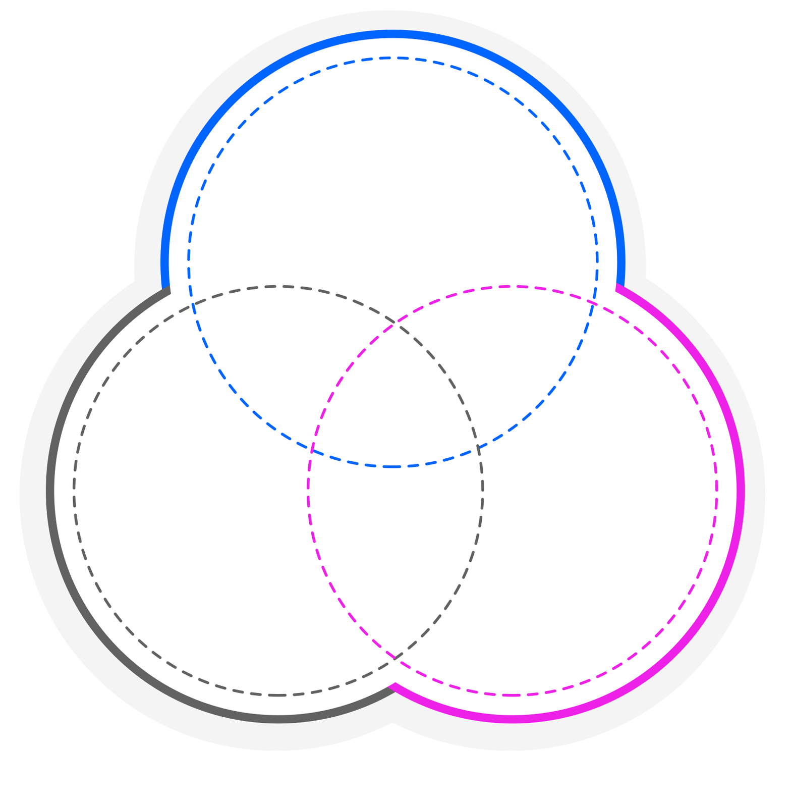
New currencies and new complexities
Two taxonomies of new forms of currency
Cryptocurrency, CPMI (2015)
Central bank digital currency, Bjerg (2017)
Not the liability of anyone
Central
bank-issued
Commodity
money
Cash
Reserves
Crypto-
currency
Central
bank digital currency
Cash
Bank deposits
Universally
accessible
Bank
account
money
Peer-to-Peer
Electronic
Electronic

Slide 8
Blockchain for business is ready for production.
But the task of developing and deploying solutions is larger than any one business can tackle on its own.
ENABLING TRUST
New technology is creating radical transparency – and uprooting how we interact, transact, and grow
NEW REVENUE STREAMS
More than a new technology, blockchain is rewriting how we
do business
66%
REMOVING BARRIERS
IBM Blockchain creates certainty, advances knowledge, brings together industries, and improves business process
Of organizations already active on blockchain are experimenting with
the business model that connects people, resources and organizations
in an ecosystem *
REINVENTING BUSINESS
Blockchain is shifting from one way of doing business to the way – creating new business solutions where there were none
Notes:
Blockchain for business is ready for production. But the task of developing and deploying solutions is larger than any one business can tackle on its own. It takes allies across departments and disciplines, industries and organizations, countries and cultures.
Increased trust increases efficiency
Blockchain results in increased operational efficiency and an enhanced customer experience.
Using blockchain to actively address security threats and protect against fraud allows businesses to manage costs and redirect resources towards innovation.
Regulation is on the rise. The last 10 years have seen the growth of global, cross-industry regulations, including HIPAA, Sarbanes-Oxley, anti-money laundering, and more. Businesses can keep pace with the complexities of regulatory compliance by automating operations and securing transactions.
A rapidly shifting business landscape, in which different entities are competing and new profit sources are being created, necessitates more trusted and secure transactions.
Early-mover insights
As blockchain becomes the standard for transactions, blockchain pioneers will have data, experience, and expertise that puts them at a competitive advantage.
Early blockchain adopters are gaining insights and expertise that can’t be quickly copied by those who hang back, and shaping the evolution of blockchain for decades to come.
Industry consortia, considered the “safe zones” for competitor meet-ups, are proliferating and shaping agreements on future business standards for blockchain.
Blockchain can be integrated with cutting-edge technology such as AI, allowing you to bring analytics to your blockchain and get to better insights faster.
Blockchain allows you to securely share data across a complex ecosystem, allowing you to fully take advantage of the data available and extract insights more quickly.
New business models
As the business landscape rapidly changes, early blockchain adopters are delivering valuable new business models and revenue streams with new partners.
Increased operational efficiency within your organization requires that you break down information silos outside your organization to realize full competitive potential.
Early adopters of blockchain realize the potential of a business network where transactions are not operated in their own silos.
8 in 10 early adopters of blockchain are investing in the technology in response to profit pools shifting in their industry or the opportunity to develop new business models.
Established and new competitors will use these technologies to reimagine and disrupt existing industries.
60% of blockchain early adopters are experimenting with a radically different business model — the platform model, which connects vast amounts of people, resources and organizations in an interactive ecosystem to create entirely new forms of business value.

Slide 9

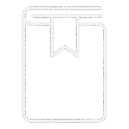

Capabilities of blockchain for business.
SHARED LEDGER
PERMISSIONING
SMART CONTRACT
CONSENSUS
Distributed system of record shared across business network
Ensuring appropriate visibility; transactions are secure & authenticated
Business terms embedded in database & executed with transactions
Transactions are endorsed by relevant participants

Slide 10
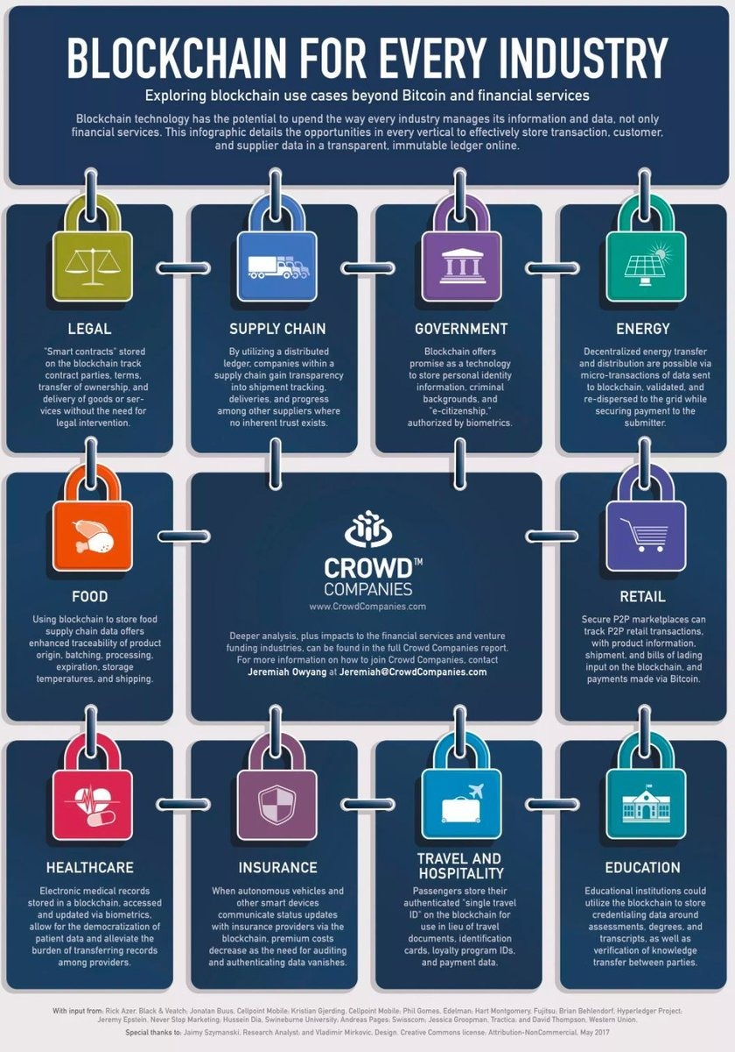
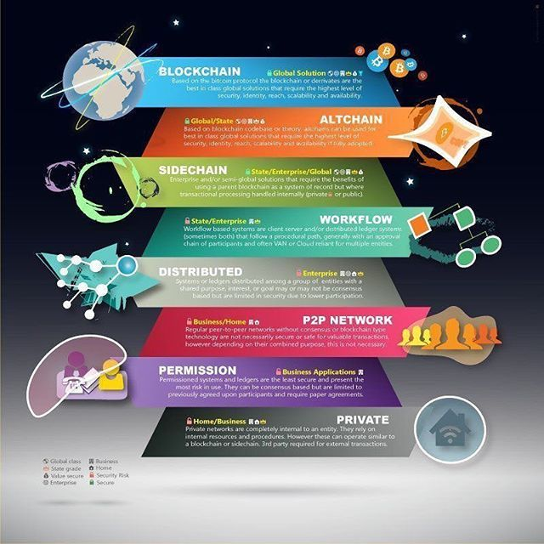
Understanding the divide – Disruption and transformation
10

Slide 11
The certainty to solve
business challenges together.
Security
at Scale
Enterprise-grade security and control on a platform where businesses and industries are reinventing themselves
Trusted
Expertise
Reinventing business processes through unrivaled industry and technical knowledge as you start, accelerate and innovate your blockchain network.
Network
Convening Power
Bringing together an expansive partner network of innovators, regulators
and suppliers to establish, join or run your blockchain network.
Notes:
HOW IBM CAN HELP (HOW IBM IS DIFFERENT)
Providing the certainty to solve business challenges together, only IBM can help you overcome the complexity of blockchain by delivering
the most secure infrastructure, deepest bench of industry experts and a partner network to allow you to commercialize your blockchain network, unlock new value, and scale up your competitive advantage.
SECURITY AT SCALE
The most secure blockchain infrastructure, with the highest security rating in the world, managed on IBM Cloud.
You can control participants, roles and access — giving you peace of mind about who can access intellectual property on your blockchain network.
We’re applying blockchain to transform regulated industries: solving problems like identity verification and bringing trust to financial transactions.
The IBM blockchain platform meets the performance and trust requirements of even the most highly-regulated industries.
We run over 55% of the world’s transactional systems, ensuring your transactions and network never go down.
TRUSTED EXPERTISE
We have the deepest bench of blockchain experts in the industry, building and running business-ready networks today.
Tap into our unparalleled experience with tools that ease collaboration and allow you to activate your blockchain network in 1/3 the time of other platforms.
We help you go further, faster: building on what you have, to stand up production-ready blockchains.
We build, run, and manage active blockchain networks for business, at scale across retail, financial services, logistics and government.
As lead contributors to Hyperledger Fabric, we designed flexibility into the technology to adapt as business needs evolve over time.
We bring analytics to your blockchain, enabling you to learn more from your blockchain data through artificial intelligence.
NETWORK CONVENING POWER
Blockchain enables new business models, only IBM has the ability to bringing together industry-leading partners, organizations, regulators and suppliers to create blockchain networks in this collaborative environment.
With over hundreds of client engagements to date, IBM has delivered some of the earliest and most successful blockchain collaborations.
America’s largest retailer puts their trust in our network to track food safety across their vendors around the world.
With more active blockchain business networks successfully running today, we can help you create the right blockchain solution.

Slide 12










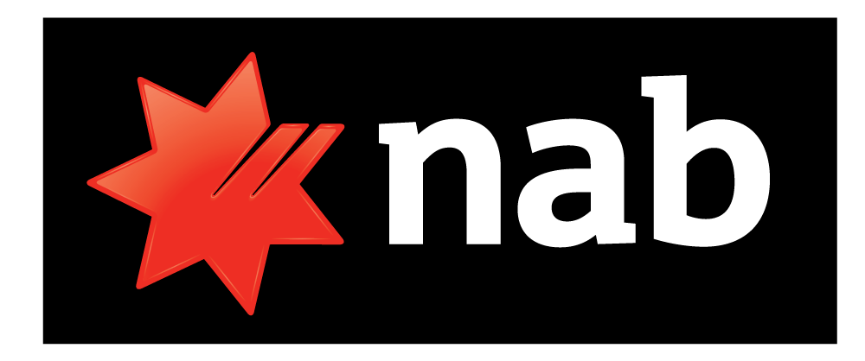










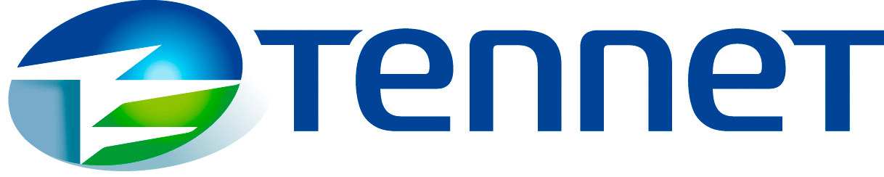










Making blockchain real for business with cross-industry solutions and dozens of active networks.
Unlisted Securities
Provenance
Bank Guarantees
Clearing & Settlement
Trade Finance
Healthcare
Universal
Payments
Global Trade
Insurance
Food Safety
Identity
Government
Distributed Energy
Notes:
By investing in and convening new collaborative blockchain networks, IBM is enabling companies to scale up their competitive advantage and unlock new value.
Collaborative platforms Scalable networks for multi-party value exchange:
1. IBM Food Trust: A solution to instantly trace food items from “farm to fork” providing transparency across the ecosystem
2. IBM Blockchain World Wire: A universal rail for real-time atomic clearing and settlement supporting the exchange of digital monetary assets
3. IBM Blockchain Trusted Identity: A trusted network empowering consumer to effortlessly and privately control their identity attributes
4. GTD: Joint Venture between Maersk & IBM focused on digital trade – enabled by blockchain to create connected world of frictionless trade

Slide 13
My focus for 2019 wrt to Blockchain
Digital identity foundation technology to ensure the trade and ownership | Digital fiat address the last-mile issue of settlement for every financial transaction | Asset tokenization ensure that digital manifestations reflect real-world assets
Security design of the blockchain system address non-repudiation, privacy, confidentiality; and verifiability of claims with consent-driven models | Business of blockchain business models a befitting business model to progress blockchain agenda | Governance model self-governance networks to consortium-defined; and semi-autonomous governance structures
$

Slide 14
What will we solve together?
Nitin Gaur
ngaur@us.ibm.com

